Slide 1

DATA – ARTIFICIAL INTELLGENCE
MySQL Database (JIT)

Slide 2
DATA MODELING IN ACTION
DATABASE ESSENTIALS
MYSQL BASICS
Notes:
YOU SHOULD HVE THE DB DEISGN SHARED. THEY SHOULD SEE THE TABLES AND ALSO THE DESIGIN THAT IS GIVEN. MAP THE DESIGN TO TABLES. ENTITIES, ATTRIBUTES, RELATIONSHIPS, KEYS

Slide 3
MYSQL
What is MySQL
Database Management is the most important part when you have humungous data around you.
MySQL is one of the most famous Relational Database to store & handle your data.
Difference Between Data and Databases?

Slide 4

Features of MySQL
MYSQL

Slide 5
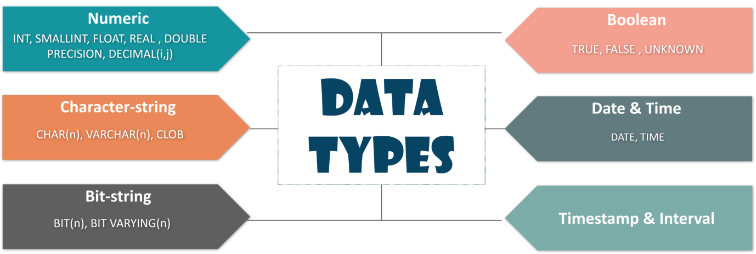
MySQL Data Types
MYSQL

Slide 6
Different Types Of Keys In Database
MYSQL
There are mainly 5 types of Keys, that can be mentioned in the database.
Candidate Key – The minimal set of attributes which can uniquely identify a tuple is known as a candidate key. A relation can hold more than a single candidate key, where the key is either a simple or composite key.
Super Key – The set of attributes which can uniquely identify a tuple is known as Super Key. So, a candidate key is a super key, but vice-versa isn’t true.
Primary Key – A set of attributes that can be used to uniquely identify every tuple is also a primary key. So, if there are 3-4 candidate keys present in a relationship, then out those, one can be chosen as a primary key.
Alternate Key – The candidate key other than the primary key is called as an alternate key.
Foreign Key – An attribute that can only take the values present as the values of some other attribute, is the foreign key to the attribute to which it refers.

Slide 7
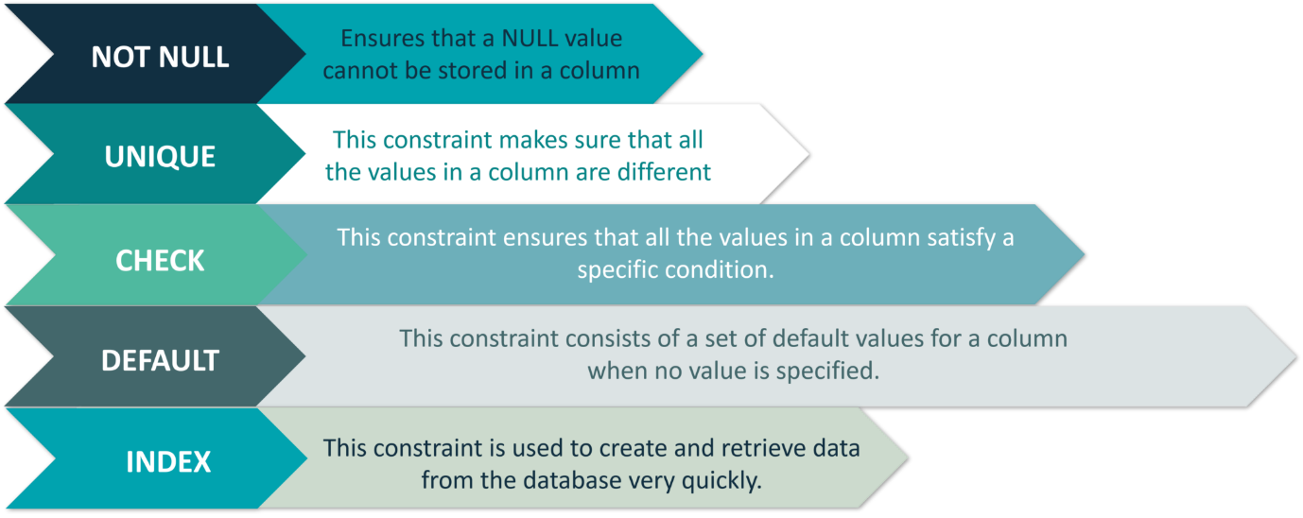
Constraints Used In Database
MYSQL

Slide 8
Structured Query Language (SQL)
SQL is the core of a relational database which is used for accessing and managing the database. By using SQL, you can add, update or delete rows of data, retrieve subsets of information, modify databases and perform many actions. The different subsets of SQL are as follows:
The DDL (Data Definition Language) consists of those commands which are used to define the database. Example: CREATE, DROP, ALTER, TRUNCATE, COMMENT, RENAME.
The DML (Data Manipulation Language) commands deal with the manipulation of data present in the database. Example: SELECT, INSERT, UPDATE, DELETE.
The DCL (Data Control Language) commands deal with the rights, permissions and other controls of the database system. Example: GRANT, INVOKE
The TCL (Transaction Control Language) consists of those commands which mainly deal with the transaction of the database.

Slide 9
Consider the below database as an example, to show you how to write commands / Queries.
StudentID | StudentName | ParentName | Address | City | PostalCode | Country | Fees
01 | Haznitiz | Emiz | Dellys Road | Afir | 35110 | Algeria | 42145
02 | Shubham | Narayan | MG Road | Bangalore | 560001 | India | 45672
03 | Salomao | Valentim | Mayo Road | Rio Claro | 27460 | Brazil | 65432
04 | Vishal | Ramesh | Queens Quay | Toronto | 416 | Canada | 23455
05 | Park Jimin | Kim Tai Hyung | Gangnam Street | Seoul | 135081 | South Korea | 22353

Slide 10
Data Definition (DDL) Commands
CREATE
The create statement is used to either create a schema, tables or an index.
The ‘CREATE DATABASE’ Statement
This statement is used to create a database.
Syntax:
CREATE DATABASE Database_Name;
Example:
 | CREATE DATABASE StudentsInfo;

Slide 11
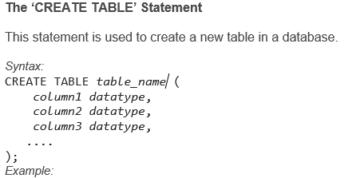
Data Definition (DDL) Commands
 | CREATE TABLE Students ( StudentID int, StudentName varchar(255), ParentName varchar(255), Address varchar(255), PostalCode int, City varchar(255) );

Slide 12
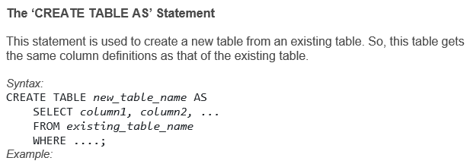
Data Definition (DDL) Commands
 | CREATE TABLE ExampleTable AS SELECT Studentname, Parentname FROM Students;

Slide 13
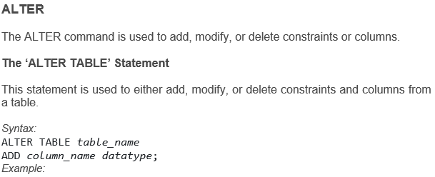
Data Definition (DDL) Commands
 | ALTER TABLE Students ADD DateOfBirth date;

Slide 14
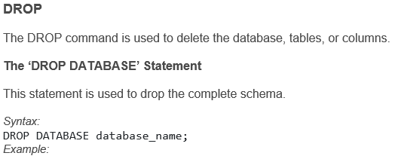
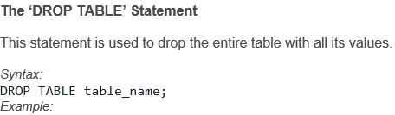
Data Definition (DDL) Commands
 | DROP DATABASE StudentsInfo;
 | DROP TABLE Students;

Slide 15
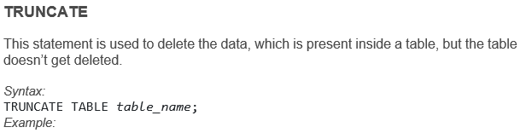
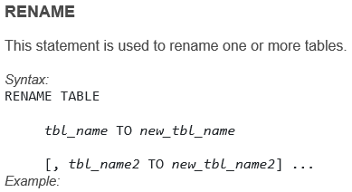
Data Definition (DDL) Commands
 | TRUNCATE TABLE Students;
 | RENAME Students TO Infostudents;

Slide 16
Data Manipulation (DML) Commands
This section consists of those commands, by which you can manipulate your database. The commands are:
USE
INSERT
UPDATE
DELETE
SELECT
Apart from these commands, there are also other manipulative operators/functions such as:
LOGICAL OPERATORS
ARITHMETIC,BITWISE,COMPARISON & COMPOUND OPERATORS
AGGREGATE FUNCTIONS
SPECIAL OPERATORS

Slide 17
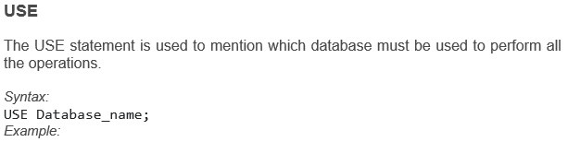
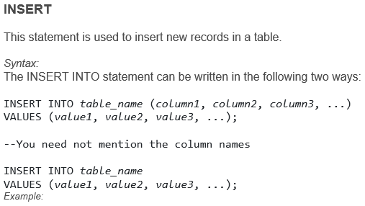
Data Manipulation (DML) Commands
 | USE StudentsInfo;
 | INSERT INTO Infostudents(StudentID, StudentName, ParentName, Address, City, PostalCode, Country) VALUES ('06', 'Sanjana','Jagannath', 'Banjara Hills', 'Hyderabad', '500046', 'India'); INSERT INTO Infostudents VALUES ('07', 'Shivantini','Praveen', 'Camel Street', 'Kolkata', '700096', 'India');

Slide 18
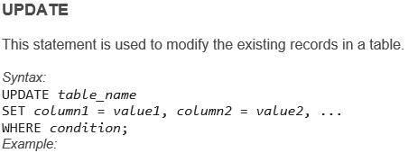
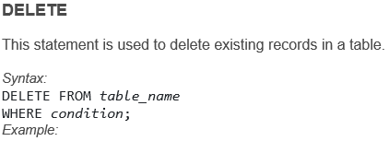
Data Manipulation (DML) Commands
1 2 3 | UPDATE Infostudents SET StudentName = 'Alfred', City= 'Frankfurt' WHERE StudentID = 1;
1 2 | DELETE FROM Infostudents WHERE StudentName='Salomao';

Slide 19
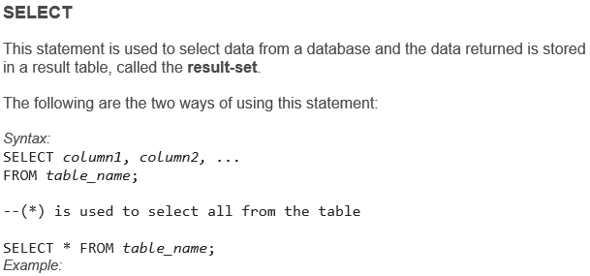
Data Manipulation (DML) Commands
 | SELECT StudentName, City FROM Infostudents; SELECT * FROM Infostudents;

Slide 20
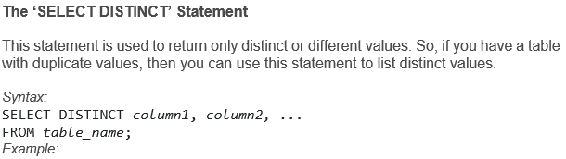
Data Manipulation (DML) Commands
Apart from the individual SELECT keyword, we will be also seeing the following statements, which are used with the SELECT keyword:
DISTINCT
ORDER BY
GROUP BY
HAVING Clause
 | SELECT Country FROM Students;

Slide 21
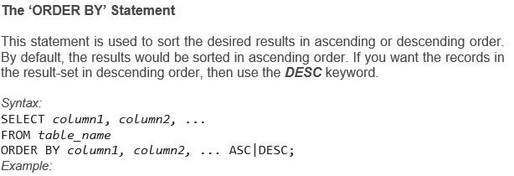
Data Manipulation (DML) Commands
 | SELECT * FROM Infostudents ORDER BY Country; SELECT * FROM Infostudents ORDER BY Country DESC; SELECT * FROM Infostudents ORDER BY Country, StudentName; SELECT * FROM Infostudents ORDER BY Country ASC, StudentName DESC;

Slide 22
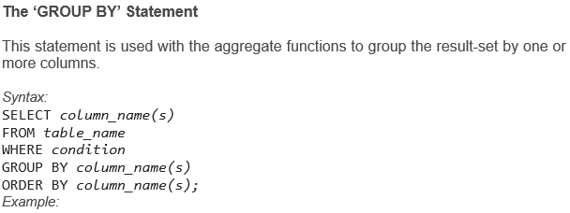
Data Manipulation (DML) Commands
 | SELECT COUNT(StudentID), Country FROM Infostudents GROUP BY Country ORDER BY COUNT(StudentID) DESC;

Slide 23
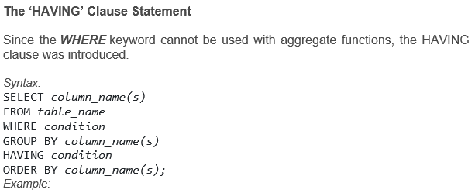
Data Manipulation (DML) Commands
 | SELECT COUNT(StudentID), City FROM Infostudents GROUP BY City HAVING COUNT(Fees) > 23000;

Slide 24
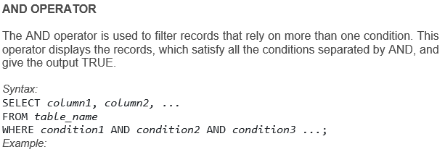
Data Manipulation (DML) Commands
LOGICAL OPERATORS
 | SELECT * FROM Infostudents WHERE Country='Brazil' AND City='Rio Claro';

Slide 25
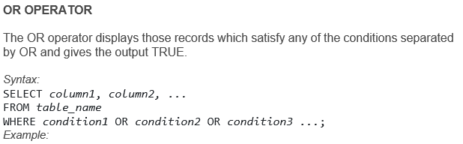
Data Manipulation (DML) Commands
 | SELECT * FROM Infostudents WHERE City='Toronto' OR City='Seoul';

Slide 26
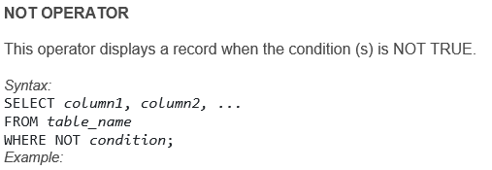
Data Manipulation (DML) Commands
 | SELECT * FROM Infostudents WHERE NOT Country='India'; --You can also combine all the above three operators and write a query like this: SELECT * FROM Infostudents WHERE Country='India' AND (City='Bangalore' OR City='Canada');

Slide 27
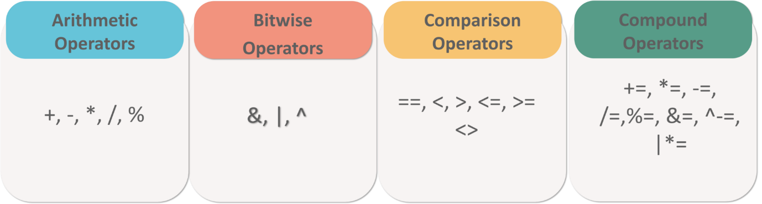
Data Manipulation (DML) Commands
ARITHMETIC, BITWISE, COMPARISON & COMPOUND OPERATORS

Slide 28
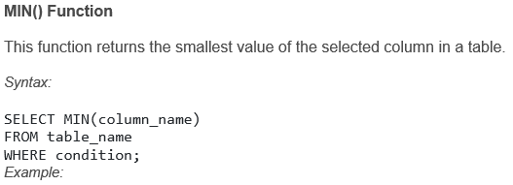
Data Manipulation (DML) Commands
AGGREGATE FUNCTIONS
MIN()
MAX()
COUNT()
AVG()
SUM()
 | SELECT MIN(StudentID) AS SmallestID FROM Infostudents;

Slide 29
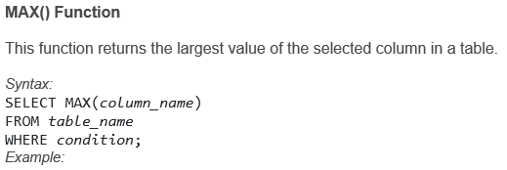
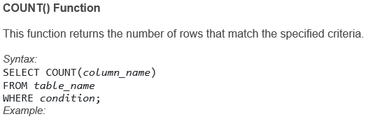
Data Manipulation (DML) Commands
 | SELECT MAX(Fees) AS MaximumFees FROM Infostudents;
 | SELECT COUNT(StudentID) FROM Infostudents;

Slide 30
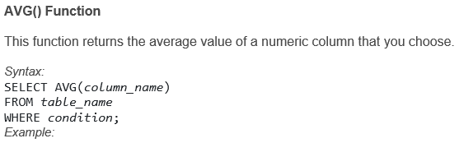
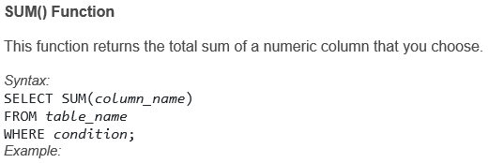
Data Manipulation (DML) Commands
 | SELECT AVG(Fees) FROM Infostudents;
 | SELECT SUM(Fees) FROM Infostudents;

Slide 31
Data Manipulation (DML) Commands
SPECIAL OPERATORS
BETWEEN
IS NULL
LIKE
IN
EXISTS
ALL
ANY

Slide 32
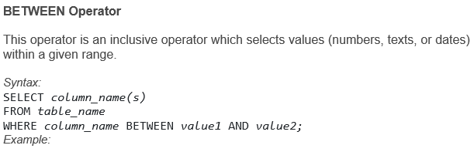
Data Manipulation (DML) Commands
 | SELECT * FROM Infostudents WHERE Fees BETWEEN 20000 AND 40000;

Slide 33
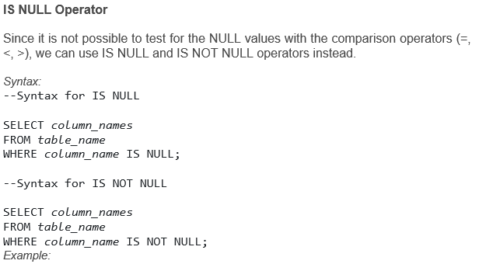
Data Manipulation (DML) Commands
 | SELECT StudentName, ParentName, Address FROM Infostudents WHERE Address IS NULL; SELECT StudentName, ParentName, Address FROM Infostudents WHERE Address IS NOT NULL;

Slide 34
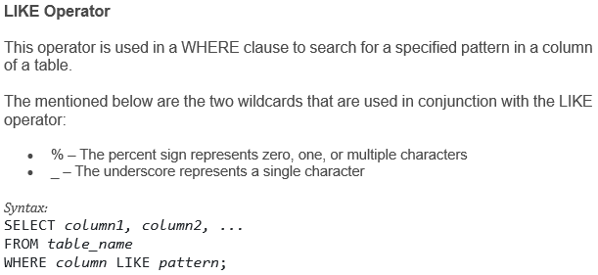
Data Manipulation (DML) Commands

Slide 35
LIKE Operator
 | SELECT * FROM Infostudents WHERE StudentName LIKE 'S%';
LIKE Operator | Description
WHERE CustomerName LIKE ‘z% | Finds any values that start with “z”
WHERE CustomerName LIKE ‘%z’ | Finds any values that end with “z”
WHERE CustomerName LIKE ‘%and%’ | Finds any values that have “and” in any position
WHERE CustomerName LIKE ‘_s%’ | Finds any values that have “s” in the second position.
WHERE CustomerName LIKE ‘d_%_%’ | Finds any values that start with “d” and are at least 3 characters in length
WHERE ContactName LIKE ‘j%l’ | Finds any values that start with “j” and ends with “l”

Slide 36
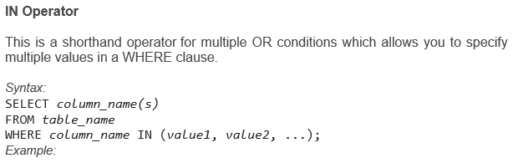
Data Manipulation (DML) Commands
 | SELECT * FROM Infostudents WHERE Country IN ('Algeria', 'India', 'Brazil');

Slide 37
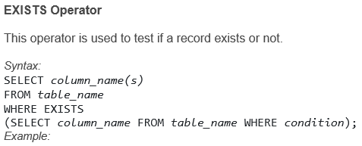
Data Manipulation (DML) Commands
 | SELECT StudentName FROM Infostudents WHERE EXISTS (SELECT ParentName FROM Infostudents WHERE StudentId = 05 AND Price < 25000);

Slide 38
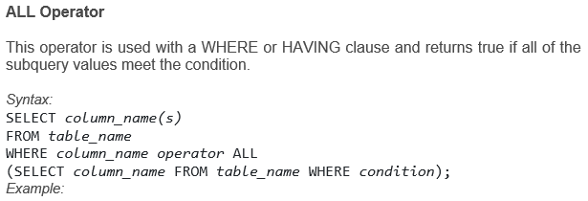
Data Manipulation (DML) Commands
 | SELECT StudentName FROM Infostudents WHERE StudentID = ALL (SELECT StudentID FROM Infostudents WHERE Fees > 20000);

Slide 39
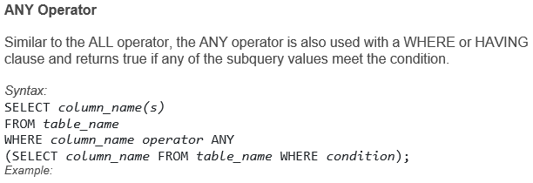
Data Manipulation (DML) Commands
 | SELECT StudentName FROM Infostudents WHERE StudentID = ANY (SELECT SttudentID FROM Infostudents WHERE Fees BETWEEN 22000 AND 23000);

Slide 40
Database Relationships
There are several types of database relationships.
One to One Relationships
One to Many and Many to One Relationships
Many to Many Relationships
When selecting data from multiple tables with relationships, we will be using the JOIN query. There are several types of JOIN’s.

Slide 41
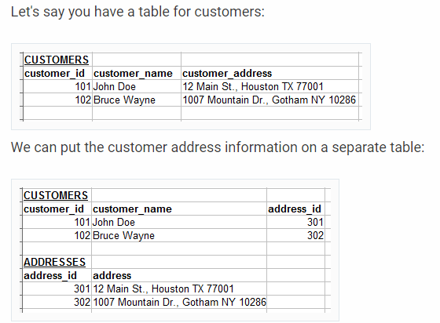
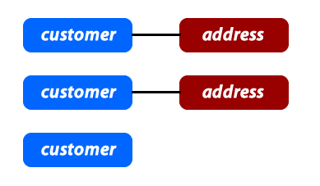
One to One

Slide 42
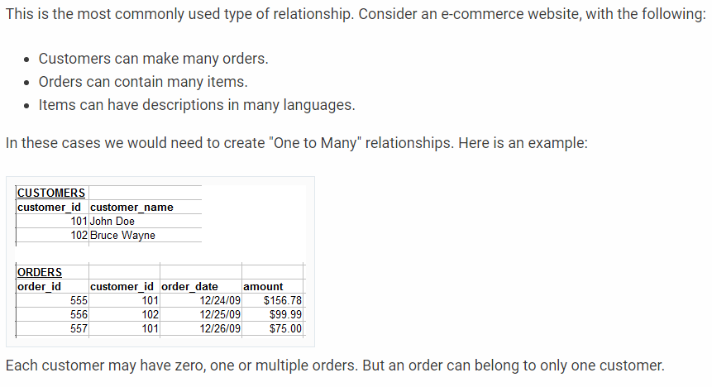
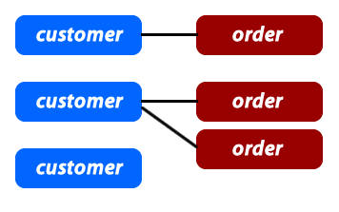
One to Many and Many to One

Slide 43
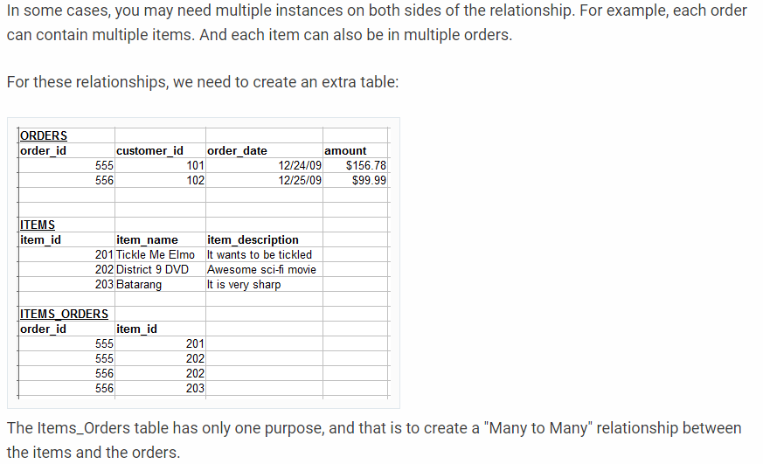
Many to Many

Slide 44
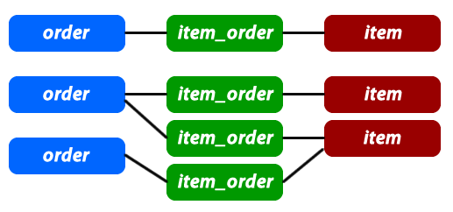
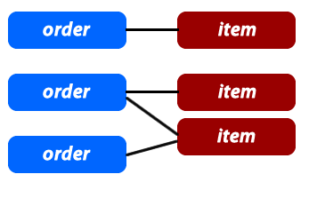
Many to Many
If you want to include the items_orders records in the graph, it may look like this:
Here is a how we can visualize this kind of relationship:

Slide 45
JOINS AND QUERY FROM MULTIPLE OBJECTS
DATABASE ESSENTIALS
JOINS

Slide 46
JOINS AND QUERY FROM MULTIPLE OBJECTS
DATABASE ESSENTIALS
JOIN is a query that combines data from more than one table by means of a single statement
Joining is done in SQL by specifying the tables to be joined in the FROM clause
Most join queries contain WHERE conditions that compare two columns, each from a different table. Such a condition is called join condition

Slide 47
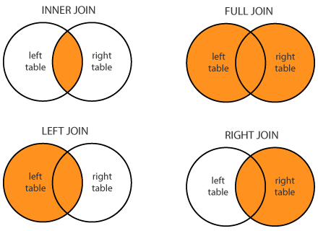
JOINS
JOINS are used to combine rows from two or more tables, based on a related column between those tables. The following are the types of joins:
INNER JOIN: This join returns those records which have matching values in both the tables.
FULL JOIN: This join returns all those records which either have a match in the left or the right table.
LEFT JOIN: This join returns records from the left table, and also those records which satisfy the condition from the right table.
RIGHT JOIN: This join returns records from the right table, and also those records which satisfy the condition from the left table.

Slide 48
JOINS
Let us consider the below table apart from the Infostudents table, to understand the syntax of joins.
CourseID | StudentID | CourseName | StartDate
1 | 10 | DevOps | 09-09-2018
2 | 11 | Blockchain | 07-04-2018
3 | 12 | Python | 08-06-2018

Slide 49
SQL JOINS
DATABASE ESSENTIALS
Inner Join
The INNER JOIN keyword selects records that have matching values in both tables.
Example: To select all orders with customer information SELECT Orders.OrderID, Customers.CustomerName FROM Orders INNER JOIN Customers ON Orders.CustomerID = Customers.CustomerID;
Orders
Customers

Slide 50
SQL JOINS
DATABASE ESSENTIALS
Left Join
The LEFT JOIN keyword returns all records from the left table (table-A), and the matched records from the right table (table-B).
Left join selects data starting from the left table and matching rows in the right table. The left join returns all rows from the left table and the matching rows from the right table.
If a row in the left table does not have a matching row in the right table, the columns of the right table will have NULL.
Example: To select all customers, and any orders they might have SELECT Customers.CustomerName, Orders.OrderID FROM Customers LEFT JOIN Orders ON Customers.CustomerID = Orders.CustomerID ORDER BY Customers.CustomerName;
A
B

Slide 51
SQL JOINS
DATABASE ESSENTIALS
Right Join
The RIGHT JOIN keyword returns all records from the right table (table-B), and the matched records from the left table (table-A). The result is NULL from the left side, when there is no match.
Example: To return all employees, and any orders they might have placed SELECT Orders.OrderID, Employees.LastName, Employees.FirstName FROM Orders RIGHT JOIN Employees ON Orders.EmployeeID = Employees.EmployeeID ORDER BY Orders.OrderID;
A
B

Slide 52
SQL JOINS
DATABASE ESSENTIALS
Full Join
The FULL OUTER JOIN keyword returns all records when there is a match in left (table-A) or right (table-B) table records.
The full outer join or full join returns a result set that contains all rows from both left and right tables, with the matching rows from both sides where available. In case there is no match, the missing side will have NULL values.
FULL OUTER JOIN and FULL JOIN are the same.
Example: To selects all customers, and all orders SELECT Customers.CustomerName, Orders.OrderID FROM Customers FULL OUTER JOIN Orders ON Customers.CustomerID = Orders.CustomerID ORDER BY Customers.CustomerName;
A
B

Slide 53
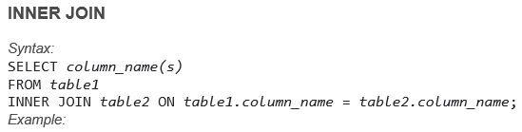
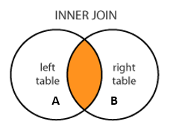
JOINS
 | SELECT Courses.CourseID, Infostudents.StudentName FROM Courses INNER JOIN Infostudents ON Courses.StudentID = Infostudents.StudentID;

Slide 54
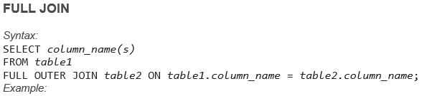
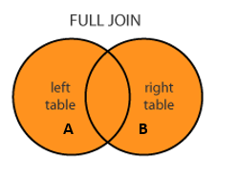
JOINS
 | SELECT Infostudents.StudentName, Courses.CourseID FROM Infostudents FULL OUTER JOIN Orders ON Infostudents.StudentID=Orders.StudentID ORDER BY Infostudents.StudentName;

Slide 55
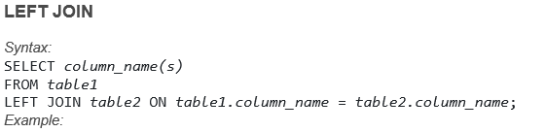
JOINS
 | SELECT Infostudents.StudentName, Courses.CourseID FROM Infostudents LEFT JOIN Courses ON Infostudents.CustomerID = Courses.StudentID ORDER BY Infostudents.StudentName;

Slide 56
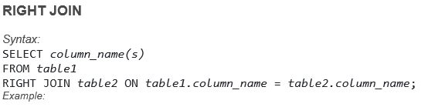
JOINS
 | SELECT Courses.CourseID FROM Courses RIGHT JOIN Infostudents ON Courses.StudentID = Infostudents.StudentID ORDER BY Courses.CourseID;

Slide 57
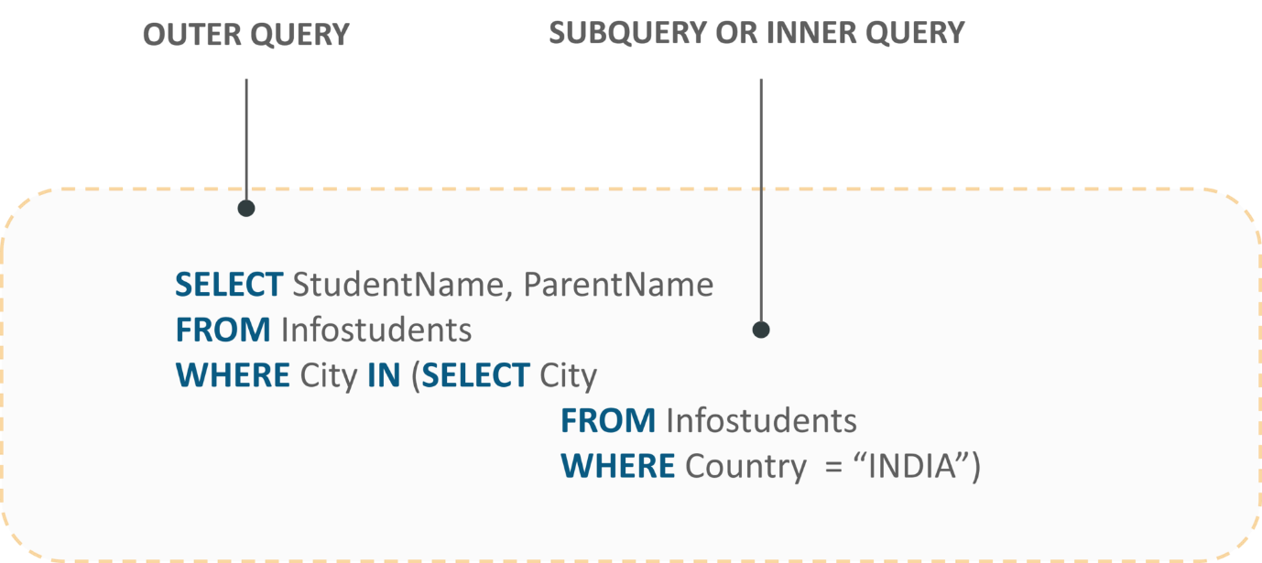
Nested Queries
Nested queries are those queries which have an outer query and inner subquery. So, basically, the subquery is a query which is nested within another query such as SELECT, INSERT, UPDATE or DELETE.

Slide 58
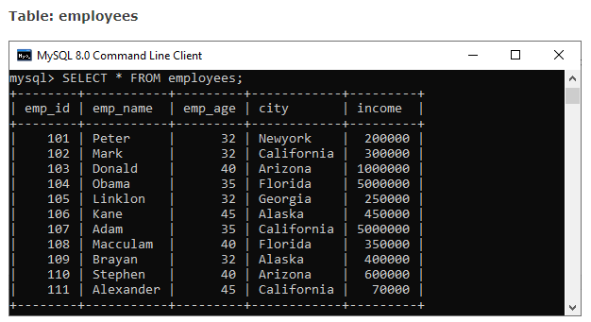
Sub Query
SELECT column_list (s) FROM table_name
WHERE column_name OPERATOR
(SELECT column_list (s) FROM table_name [WHERE])

Slide 59

Sub Query Example
SELECT emp_name, city, income FROM employees
WHERE emp_id IN (SELECT emp_id FROM employees);

Slide 60


SELECT * FROM employees
WHERE emp_id IN (SELECT emp_id FROM employees
WHERE income > 350000);
SELECT emp_name, city, income FROM employees
WHERE income = (SELECT MAX(income) FROM employees);

Slide 61

SELECT emp_name, city, income
FROM employees emp WHERE income > (
SELECT AVG(income) FROM employees WHERE city = emp.city);

Slide 62


Slide 63

SELECT name, occupation, age FROM customer C
WHERE EXISTS (SELECT * FROM Orders O
WHERE C.cust_id = O.cust_id);
SELECT name, occupation, age FROM customer C
WHERE NOT EXISTS (SELECT * FROM Orders O
WHERE C.cust_id = O.cust_id);

Slide 64
MySQL Transaction
A transaction in MySQL is a sequential group of statements, queries, or operations such as select, insert, update or delete to perform as a one single work unit that can be committed or rolled back. If the transaction makes multiple modifications into the database, two things happen:
Either all modification is successful when the transaction is committed.
Or all modifications are undone when the transaction is rollback.
In other words, a transaction cannot be successful without completing each operation available in the set. It means if any statement fails, the transaction operation cannot produce results.
A transaction in MySQL starts with the first executable SQL statement and ends when it finds a commit or rolled back either explicitly or implicitly. It explicitly uses COMMIT or ROLLBACK statement and implicitly when a DDL statement is used.

Slide 65
MySQL Transaction Statement
MySQL provides a START TRANSACTION statement to begin the transaction. It also offers a "BEGIN" and "BEGIN WORK" as an alias of the START TRANSACTION.
We will use a COMMIT statement to commit the current transaction. It allows the database to make changes permanently.
We will use a ROLLBACK statement to roll back the current transaction. It allows the database to cancel all changes and goes into their previous state.
We will use a SET auto-commit statement to disable/enable the auto-commit mode for the current transaction. By default, the COMMIT statement executed automatically.
SET autocommit = 0;
OR,
SET autocommit = OFF:
SET autocommit = 1;
OR,
SET autocommit = ON:

Slide 66



Slide 67
-- 1. Start a new transaction
START TRANSACTION;
-- 2. Get the highest income
SELECT @income:= MAX(income) FROM employees;
-- 3. Insert a new record into the employee table
INSERT INTO employees(emp_id, emp_name, emp_age, city, income)
VALUES (111, 'Alexander', 45, 'California', 70000);
-- 4. Insert a new record into the order table
INSERT INTO Orders(order_id, prod_name, order_num, order_date)
VALUES (6, 'Printer', 5654, '2020-01-10');
-- 5. Commit changes
COMMIT;

Slide 68


Slide 69


ROLLBACK Example
-- 1. Start a new transaction
START TRANSACTION;
-- 2. Delete data from the order table
DELETE FROM Orders;
Now, we need to open a separate session of MySQL database server and execute the below statement to verify the data in Orders table:
SELECT * FROM Orders;

Slide 70

-- 3. Rollback changes
ROLLBACK;
-- 4. Verify the records in the first session
SELECT * FROM Orders;
MySQL Transaction cannot be able to roll back all statements. For example, these statements include DDL (Data Definition Language) commands such as CREATE, ALTER, or DROP database as well as CREATE, UPDATE, or DROP tables or stored routines. We have to make sure that when we design our transaction, these statements do not include.

Slide 71
SAVEPOINT, ROLLBACK TO SAVEPOINT, RELEASE SAVEPOINT
The SAVEPOINT statement creates a special mark with the name of the identifier inside a transaction. It allows all statements that are executed after savepoint would be rolled back. So that the transaction restores to the previous state it was in at the point of the savepoint.
If we have set multiple savepoints in the current transaction with the same name, the newly savepoint is responsible for rollback.
The ROLLBACK TO SAVEPOINT statement allows us to rolls back all transactions to the given savepoint was established without aborting the transaction.
The RELEASE SAVEPOINT statement destroys the named savepoint from the current transaction without undoing the effects of queries executed after the savepoint was established. After these statements, no rollback command occurs. If the savepoint does not exist in the transaction, it gives an error.
SYNTAX: SAVEPOINT savepoint_name
ROLLBACK TO [SAVEPOINT] savepoint_name
RELEASE SAVEPOINT savepoint_name

Slide 72
START TRANSACTION;
SELECT * FROM Orders;
INSERT INTO Orders(order_id, prod_name, order_num, order_date)
VALUES (6, 'Printer', 5654, '2020-01-10');
SAVEPOINT my_savepoint;
INSERT INTO Orders(order_id, prod_name, order_num, order_date)
VALUES (7, 'Ink', 5894, '2020-03-10');
ROLLBACK TO SAVEPOINT my_savepoint;
INSERT INTO Orders(order_id, prod_name, order_num, order_date)
VALUES (8, 'Speaker', 6065, '2020-02-18');
COMMIT;

Slide 73


Slide 74

Now, we will use a SELECT statement to verify the above operation. In the output, we can see that the order_id=6 and order_id=8 is added successfully, but order_id=7 is not inserted into the table. It rolls back the values entered after the savepoint was established:

Slide 75
START TRANSACTION;
INSERT INTO Orders(order_id, prod_name, order_num, order_date)
VALUES (7, 'Ink', 5894, '2020-03-10');
SAVEPOINT my_savepoint;
UPDATE Orders SET prod_name='Scanner' WHERE order_id=8;
RELEASE SAVEPOINT my_savepoint;
COMMIT;

Slide 76


Slide 77

How to select nth Highest Record in MySQL
SELECT * FROM table_name ORDER BY colm_name DESC LIMIT n - 1, 1;

Slide 78


Suppose we want to get the second highest salary of an employee (n = 2) in the Employee table; we can use the below statement:
SELECT name, salary FROM Employee ORDER BY salary DESC LIMIT 1, 1;
Suppose we want to get the third-highest salary of an employee (n = 3) in the Employee table; we can use the below statement:
SELECT name, salary FROM Employee ORDER BY salary DESC LIMIT 2, 1;

Slide 79

Get the nth highest record using a subquery
SELECT name, salary FROM Employee AS emp1
WHERE N-1 = (SELECT COUNT(DISTINCT salary) FROM Employee emp2
WHERE emp2.salary > emp1.salary)
Below query that returns the second highest salary from the employee table using the subquery
SELECT name, salary FROM Employee AS emp1
WHERE 2-1 = (SELECT COUNT(DISTINCT salary) FROM Employee AS emp2
WHERE emp2.salary > emp1.salary);

Slide 80

Find Duplicate Records

Slide 81

SYNTAX: SELECT column, COUNT(column)
FROM table_name
GROUP BY column
HAVING COUNT(column) > 1;
To find rows that have duplicate names in the student_contacts table:
SELECT name, email, COUNT(name)
FROM student_contacts
GROUP BY name
HAVING COUNT(name) > 1;

Slide 82

Find Duplicate data in multiple columns
SELECT
name, COUNT(name),
state, COUNT(state),
email, COUNT(email)
FROM student_contacts
GROUP BY name, state, email
HAVING COUNT(name) > 1
AND COUNT(state) > 1
AND COUNT(email) > 1;

Slide 83

Delete Duplicate Records
DELETE S1 FROM student_contacts AS S1
INNER JOIN student_contacts AS S2
WHERE S1.id < S2.id AND S1.email = S2.email;
This query references the student_contacts table twice. Therefore, we will use table alias S1 and S2. After executing the statement, we will get the following output:

Slide 84


SELECT name, email, COUNT(name)
FROM student_contacts
GROUP BY name
HAVING COUNT(name) > 1;

Slide 85
Duplicate one data table to another
CREATE TABLE new_table
SELECT col, col2, col3
FROM
existing_table;
CREATE TABLE new_table
SELECT col1, col2, col3
FROM
existing_table
WHERE
conditions;

Slide 86
Grant and Revoke
Data Controlling Language (DCL) helps users to retrieve and modify the data stored in the database with some specified queries. Grant and Revoke belong to these types of commands of the Data controlling Language. DCL is a component of SQL commands.
1. Grant : SQL Grant command is specifically used to provide privileges to database objects for an user. This command also allows users to grant permissions for other users too.
grant privilege_name on object_name
to {user_name | public | role_name}
Here privilege_name is which permission has to be granted, object_name is the name of the database object, user_name is the user to which access should be provided, public is used to permit the access to all the users.

Slide 87
Grant and Revoke
2. Revoke : Revoke command withdraw user privileges on database objects if any granted. It does operations opposite to the Grant command. When a privilege is revoked from a particular user U, then the privileges granted to all other users by user U will be revoked.
revoke privilege_name on object_name
from {user_name | public | role_name}
Example:
grant insert,
select on accounts to Ram
By the above command user ram has granted permissions on accounts database object like he can query or insert into accounts.
revoke insert,
select on accounts from Ram
By the above command user ram’s permissions like query or insert on accounts database object has been removed.

Slide 88

UI Programming
Web Technologies & User Experience Design
THANK YOU

